Slide 2
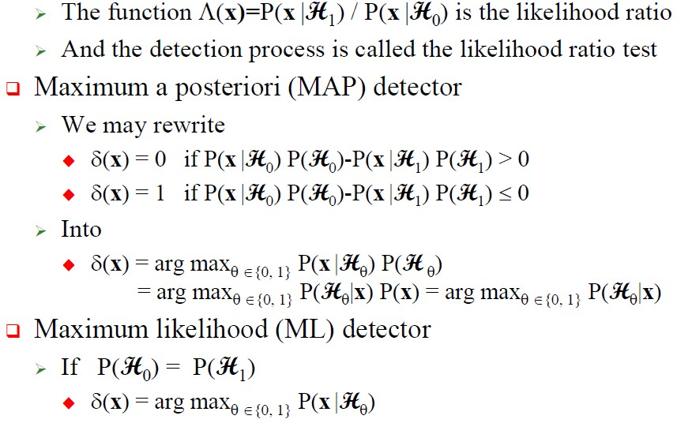
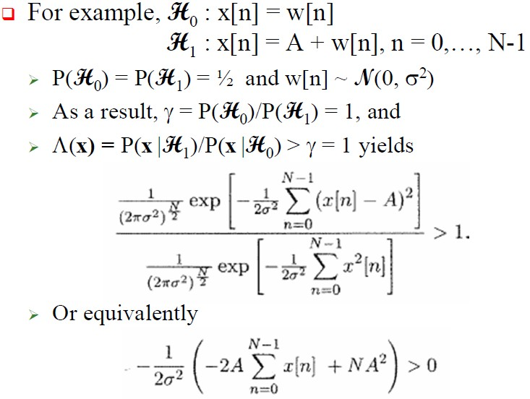
3rd Year
Detection and Estimation Theory
Dept. of Communications Eng.

Slide 3
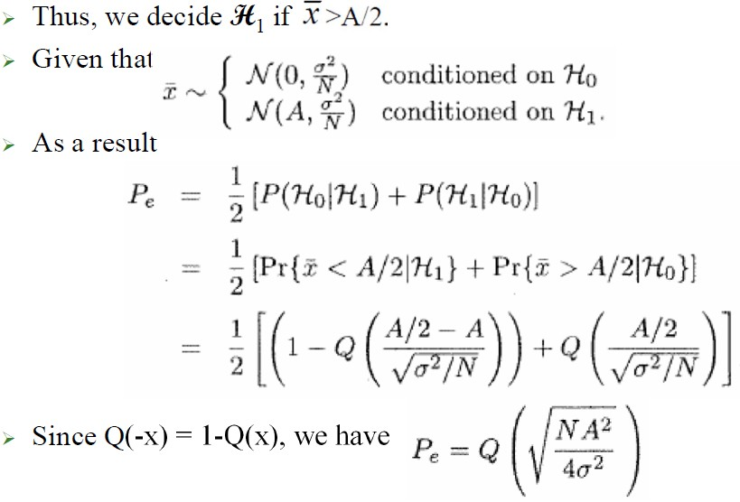
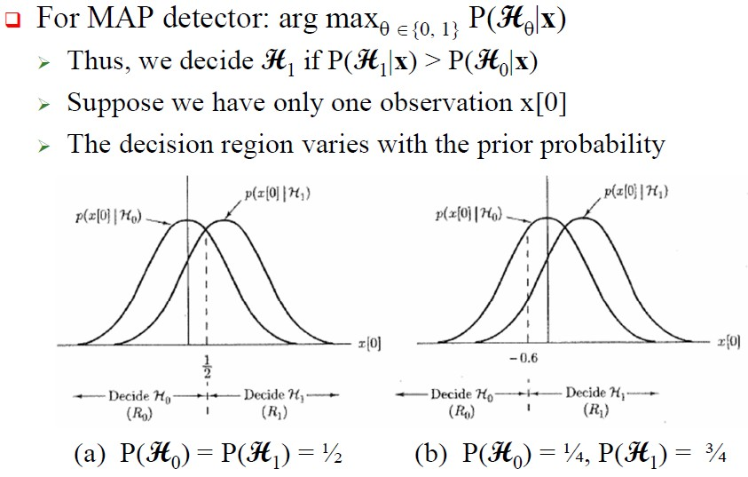
3rd Year
Detection and Estimation Theory
Dept. of Communications Eng.

Slide 4
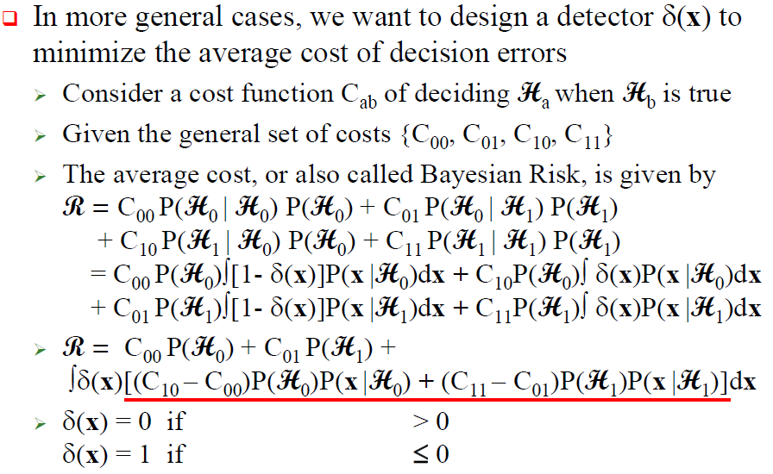
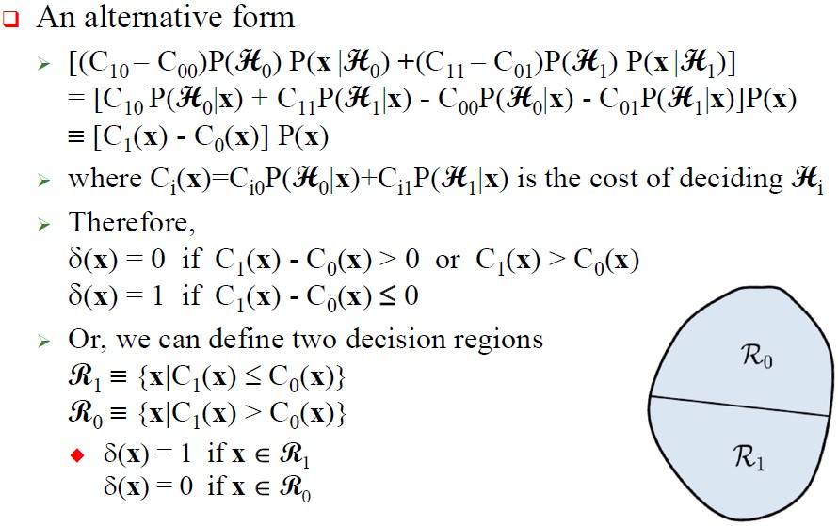
3rd Year
Detection and Estimation Theory
Dept. of Communications Eng.

